Slide 1

The bisection method

Slide 2
Introduction
In this topic, we will
  Describe the idea behind the bisection method
  Determine how fast it converges
    We will compare it to Newton’s method
  Look at an example
  Compare the algorithm with Newton’s method
  Look at an implementation

Slide 3
Bracketing a root
Suppose we have a real-valued function of real variable and suppose that a_{k} and b_{k} are two points such that f (a_{k}) and f (b_{k}) have opposite signs
  If f is continuous, the f must have a root on [a_{k}, b_{k}]
f (x)
a_{k}
b_{k}

Slide 4
Bracketing a root
Suppose we have a real-valued function of real variable and suppose that a_{k} and b_{k} are two points such that f (a_{k}) and f (b_{k}) have opposite signs
  If f is continuous, the f must have a root on [a_{k}, b_{k}]
f (x)
a_{k}
b_{k+1}
b_{k}
₊₁

Slide 5
Calculating the mid-point
Thus, given two bounds a_{k} and b_{k} such that f (a_{k}) and f (b_{k}) have opposite signs
  Find the mid-point
  If , we have found a root, so we are done
  If and have opposite signs,
  let a_{k+1} ← a_{k} and b_{k+1} ← m_{k}
  Otherwise, and have opposite signs,
  let a_{k+1} ← m_{k} and b_{k+1} ← b_{k}

Slide 6
Error analysis
Approximate the root by choosing whichever end-point has the smallest absolute value
  What is the maximum error?
  The root could be arbitrarily close to the other end-point,
  so the maximum error is h = b_{k} – a_{k}
  With each step, the maximum error is halved, or ½h
    Thus, if h is the error, this technique is O(h)

Slide 7
Example
Find the first root of 2e^{–2x} – e^{–x} starting with [0, 1]
  The solution is ln(2)
Maximum
error
0.5 0.1292
0.75 –0.02611
0.625 0.03775
0.6875 0.002848
0.71875 –0.01232
0.703125 –0.004915
0.6953125 –0.001079
0.69140625 0.0008727
0.693359375 –0.0001061
0.6923828125 0.0003826
0 0 1 1.0 –0.09721 1
1 0.5 1 0.1292 –0.09721 0.5
2 0.5 0.75 0.1292 –0.02611 0.25
3 0.625 0.75 0.03775 –0.02611 0.125
4 0.6875 0.75 0.00285 –0.02611 0.0625
5 0.6875 0.71875 0.00285 –0.01232 0.03125
6 0.6875 0.703125 0.00285 –0.004915 0.015625
7 0.6875 0.6953125 0.00285 –0.001079 0.0078125
8 0.69140625 0.6953125 0.0008727 –0.001079 0.00390625
9 0.69140625 0.693359375 0.0008727 –0.0001061 0.001953125
10 0.6923828125 0.693359375 0.0003826 –0.0001061 0.0009765625

Slide 8
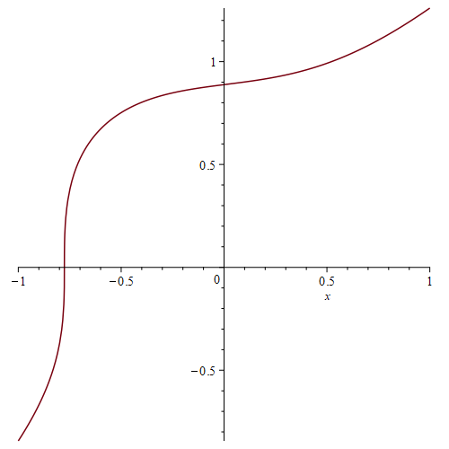
Comparison with Newton’s method
The bisection method converges very slowly
  However, if there is a root and if f is continuous on [a₀, b₀],
  it is very likely to converge
  It may not converge if the slope at the root is close to infinity
    For example,

Slide 9

Implementation
double bisection( std::function<double( double x )> f,
double a, double b,
double eps_step, double eps_abs,
unsigned int max_iterations ) {
assert( a < b );
double fa{ f( a ) };
double fb{ f( b ) };
  if ( !std::isfinite( fa ) || !std::isfinite( fb ) ) {
  return NAN;
  }
if ( fa == 0.0 ) {
return a;
}
if ( fb == 0.0 ) {
return b;
}
C/C++ Code is provided to demonstrate the straight-forward nature of these algorithms and not required for the examination

Slide 10
Implementation
for ( unsigned int k{0}; k < max_iterations; ++k ) {
double m{ a + (b - a)/2.0 }; // This avoids overflow
double fm{ f( m ) };
  if ( !std::isfinite( fm ) ) {
  return NAN;
  }
if ( fm == 0.0 ) {
return m;
}
a = m;
fa = fm;
}
b = m;
fb = fm;
}
else if ( std::signbit( fa ) == std::signbit( fm ) ) {
else {
C/C++ Code is provided to demonstrate the straight-forward nature of these algorithms and not required for the examination

Slide 11
Implementation
if ( (b - a) < eps_step ) {
if ( std::abs( fa ) <= std::abs( fb ) ) {
if ( std::abs( fa ) < eps_abs ) {
return a;
}
} else {
if ( std::abs( fb ) < eps_abs ) {
return b;
}
}
}
}
return NAN;
}
C/C++ Code is provided to demonstrate the straight-forward nature of these algorithms and not required for the examination

Slide 12
Summary
Following this topic, you now
  Understand the idea behind the bisection method
  Know that it converges according to O(h)
  Have seen an example
  Understand that it will generally converge under normal conditions
  Considered an implementation

Slide 13
References
[1] https://en.wikipedia.org/wiki/Bisection_method

Slide 14
Acknowledgments
None so far.

Slide 15



Colophon
These slides were prepared using the Cambria typeface. Mathematical equations use Times New Roman, and source code is presented using Consolas. Mathematical equations are prepared in MathType by Design Science, Inc.
Examples may be formulated and checked using Maple by Maplesoft, Inc.
The photographs of flowers and a monarch butter appearing on the title slide and accenting the top of each other slide were taken at the Royal Botanical Gardens in October of 2017 by Douglas Wilhelm Harder. Please see
https://www.rbg.ca/
for more information.

Slide 16
Disclaimer
These slides are provided for the ece 204 Numerical methods course taught at the University of Waterloo. The material in it reflects the author’s best judgment in light of the information available to them at the time of preparation. Any reliance on these course slides by any party for any other purpose are the responsibility of such parties. The authors accept no responsibility for damages, if any, suffered by any party as a result of decisions made or actions based on these course slides for any other purpose than that for which it was intended.

